Slide 1
Day Month 2023
[Insert Church
Name]
Notes:
7:30pm | MC Welcome & Prayer

Slide 2
[Insert Music Lyrics (if applicable)]
CCLI Song Details
Notes:
7:35pm | 2x Songs

Slide 3
[ Insert Bible Reading ]
Multiplying Gospel Workers through Ministry Apprenticeships
Notes:
7:45pm | Prayer & Bible Reading

Slide 4
[ Insert Bible Talk Slides ]
Multiplying Gospel Workers through Ministry Apprenticeships
Notes:
7:45pm | Bible Talk

Slide 5
Interview
[Insert Apprentice & Trainer Names]
Notes:
8:05pm | Trainer & Apprentice Interview

Slide 6
The MTS Vision
“To win the world for Christ by Multiplying Gospel Workers through Ministry Apprenticeships”
Multiplying Gospel Workers through Ministry Apprenticeships
Notes:
8:20pm | Unpacking MTS Apprenticeships

Slide 7
The MTS Mission
“To raise up, train and resource MTS Trainers, as they multiply Gospel Workers through Ministry Apprenticeships”
Multiplying Gospel Workers through Ministry Apprenticeships
Notes:
8:20pm | Unpacking MTS Apprenticeships

Slide 8
The MTS Mission Objectives
Recruit and grow the number of active Trainers
Equip and help Trainers to Recruit Apprentices
Equip and help Trainers to Train Apprentices
Retain and Grow (Develop) Trainers to be Entrusters
Develop indigenous MTS movements internationally
Multiplying Gospel Workers through Ministry Apprenticeships
Notes:
8:20pm | Unpacking MTS Apprenticeships

Slide 9
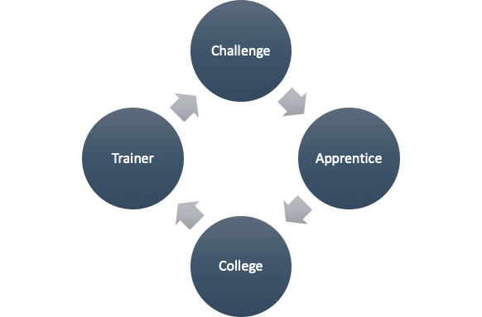
The MTS Strategy
Multiplying Gospel Workers through Ministry Apprenticeships
Notes:
8:20pm | Unpacking MTS Apprenticeships

Slide 10
Why Train by Apprenticeship?
Character
Apprentices are trained by an experienced Pastor, who helps grow your ‘life & doctrine’ (1 Tim 4:16)
Apprentices receive tailored training, because ‘one size does not fit all’
Apprentices complete their apprenticeship with far more regular prayer & Bible reading patterns
Multiplying Gospel Workers through Ministry Apprenticeships
Notes:
8:20pm | Unpacking MTS Apprenticeships

Slide 11
Why Train by Apprenticeship?
Conviction
Apprentices integrate God’s Word, life and ministry
Apprenticeships prepare you for formal theological training
Apprentices learn very quickly that they are not sovereign, but God is
Multiplying Gospel Workers through Ministry Apprenticeships
Notes:
8:20pm | Unpacking MTS Apprenticeships

Slide 12
Why Train by Apprenticeship?
Competence
Apprenticeships are on-the-job training
Apprentices typically have their week structured into three parts:
Leadership in a familiar ministry
Learning a less familiar ministry
Starting a new outreach initiative
Apprentices learn that ministry is about people, not programs
Multiplying Gospel Workers through Ministry Apprenticeships
Notes:
8:20pm | Unpacking MTS Apprenticeships

Slide 13
Apprenticeship Pathways
There are two pathways:
Team Leader
Involves going to Bible College after your apprenticeship
Team Member
Involves part-time theological study during your apprenticeship
Multiplying Gospel Workers through Ministry Apprenticeships
Notes:
8:20pm | Unpacking MTS Apprenticeships

Slide 14
Apprenticeship Pathways: Team Leader
Assumes:
You will go on to Bible College after your apprenticeship
You will complete 4hrs/pw of online certificate level study during your apprenticeship
The Study: The Timothy Partnership
Australian College of Theology affiliated through Youthworks and Christ College
Written and led by experts in their field
Works across denominations to find the experts
Multiplying Gospel Workers through Ministry Apprenticeships
Notes:
8:20pm | Unpacking MTS Apprenticeships

Slide 15
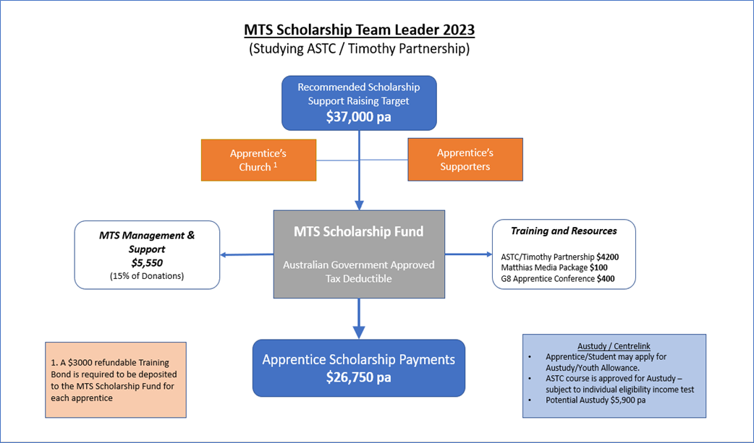
The Finances
Multiplying Gospel Workers through Ministry Apprenticeships
Notes:
8:20pm | Unpacking MTS Apprenticeships

Slide 16
Your Next Steps
Potential Apprentices
mtsrecruit.online
MTS Recruit Conferences run
during October - November
How will you serve Jesus with your whole life?
Multiplying Gospel Workers through Ministry Apprenticeships
Notes:
8:35pm | Your Next Steps

Slide 17
Your Next Steps
Future Trainers
Who has the most influence on your decision to participate in a ministry apprenticeship?
Contact Russell Smidt: 0431 015 292
Identify and mentor godly men and women who could be future MTS Apprentices
Stay faithful. It typically takes three years for a person to start an apprenticeship
Family
Other
Christian Friends
Christian
Teacher
Minister or senior leader
Mentor
The apprentice in my church/uni
Multiplying Gospel Workers through Ministry Apprenticeships
Notes:
8:35pm | Your Next Steps

Slide 18
Your Next Steps
Potential Training Centres
Contact Russell Smidt: 0431 015 292
Budget for an Apprentice for next year and beyond
Identify and mentor godly men and women who could be future MTS Apprentices
Multiplying Gospel Workers through Ministry Apprenticeships
Notes:
8:35pm | Your Next Steps

Slide 19
Q&A
[Insert Panel Names]
Notes:
8:45pm | Question Time

Slide 20
Thank You for Coming
Please talk to [insert name] for more info about your next steps
Notes:
9:00pm | Finish & Prayer

