Slide 1


MTS In Focus Event
Date/Month/Year

Slide 2

[Insert Music Lyrics (if applicable)]
CCLI Song Details

Slide 3
[ Insert Bible Reading ]
Multiplying Gospel Workers through Ministry Apprenticeships

Slide 4
[ Insert Bible Talk Slides ]
Multiplying Gospel Workers through Ministry Apprenticeships

Slide 5
Interview
Insert Trainer and Apprentice name
Multiplying Gospel Workers through Ministry Apprenticeships

Slide 6
The MTS Vision
To win the world for Christ by Multiplying Gospel Workers through Ministry Apprenticeships
Multiplying Gospel Workers through Ministry Apprenticeships

Slide 7
The MTS Purpose
To grow a movement of healthy, inspired, multiplying Gospel Ministry Trainers
Multiplying Gospel Workers through Ministry Apprenticeships

Slide 8
The MTS Mission
Raise, train and resource Gospel Ministry Trainer formation and fellowship
Multiplying Gospel Workers through Ministry Apprenticeships

Slide 9


The MTS Strategy
Challenge
Trainer
Apprentice
College
Multiplying Gospel Workers through Ministry Apprenticeships

Slide 10
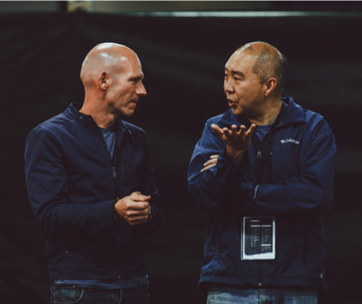
Why Train by Apprenticeship?
Character
  Apprentices are trained by an experienced Pastor, who helps grow your ‘life & doctrine’ (1 Tim 4:16)
  Apprentices receive tailored training, because ‘one size does not fit all’
  Apprentices complete their apprenticeship with far more regular prayer & Bible reading patterns
Multiplying Gospel Workers through Ministry Apprenticeships

Slide 11

Why Train by Apprenticeship?
Conviction
  Apprentices integrate God’s Word, life and ministry
  Apprenticeships prepare you for formal theological training
  Apprentices learn very quickly that they are not sovereign, but God is
Multiplying Gospel Workers through Ministry Apprenticeships

Slide 12

Why Train by Apprenticeship?
Competence
  Apprenticeships are on-the-job training
  Apprentices typically have their week structured into three parts:
    Leadership in a familiar ministry
    Learning a less familiar ministry
    Starting a new outreach initiative
  Apprentices learn that ministry is about people, not programs
Multiplying Gospel Workers through Ministry Apprenticeships

Slide 13
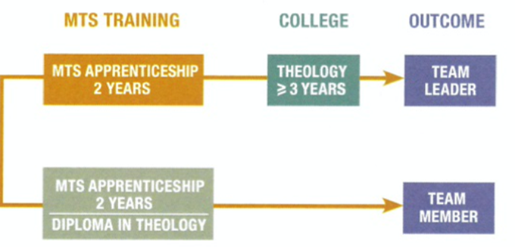
Apprenticeship Pathways
There are two pathways:
  Team Leader
    Involves going to Bible College after your apprenticeship
  Team Member
    Involves part-time theological study during your apprenticeship
Multiplying Gospel Workers through Ministry Apprenticeships

Slide 14
Apprenticeship Pathways: Team Leader
Assumes:
  You will go on to Bible College after your apprenticeship
  You will complete 4hrs/pw of online certificate level study during your apprenticeship
The Study: The Timothy Partnership
  Australian College of Theology affiliated through Youthworks and Christ College
  Written and led by experts in their field
  Works across denominations to find the experts
Multiplying Gospel Workers through Ministry Apprenticeships

Slide 15
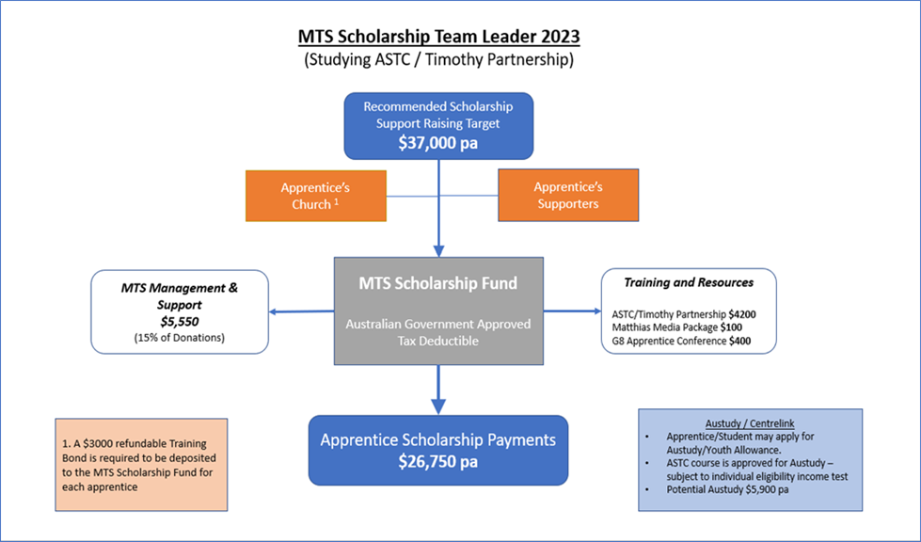
The Finances
Please email jlee@mts.com.au for updated statistics graphic
Multiplying Gospel Workers through Ministry Apprenticeships

Slide 16

Your Next Steps
Potential Apprentices
mtsrecruit.online
MTS Recruit Conferences run
during October - November
How will you serve Jesus with your whole life?
Please Contact jlee@mts.com.au for updated information on MTS Recruiting Conferences
Multiplying Gospel Workers through Ministry Apprenticeships

Slide 17
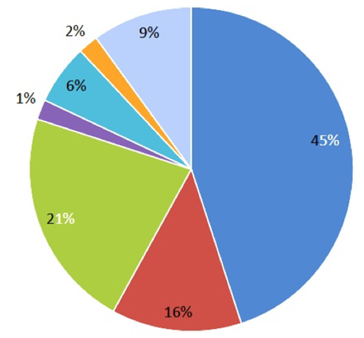
Your Next Steps
Future Trainer
  Contact Russell Smidt: 0431 015 292
  Identify and mentor godly men and women who could be future MTS Apprentices
  Stay faithful. It typically takes three years for a person to start an apprenticeship
Family
Other
Christian Friends
Christian Teacher
Minister or Senior Leader
Mentor
The Apprentice in my church/Uni
Multiplying Gospel Workers through Ministry Apprenticeships

Slide 18
Your Next Steps
Potential Training Centres
  Contact Russell Smidt: 0431 015 292
  Budget for an Apprentice for next year and beyond
  Identify and mentor godly men and women who could be future MTS Apprentices
Multiplying Gospel Workers through Ministry Apprenticeships

Slide 19
Q & A
Insert Panel Names
Multiplying Gospel Workers through Ministry Apprenticeships

Slide 20
Thank You for Coming!
Please talk to [insert name] for more info about your next steps
Multiplying Gospel Workers through Ministry Apprenticeships

